Slide 1


CS-3002: Information Security
Lecture # 9: Authentication and Access Control
Department of Software Engineering
FAST-NUCES

Slide 2
Overview
Authentication
Passwords
Secure ID
Google 2-step Authentication
Access Control

Slide 3
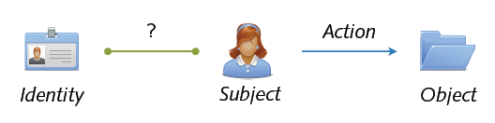
Authentication
Authentication = binding of an identity to a subject
Confirmation of identity by ...
Knowledge factors = what the entity knows
Ownership factors = what the entity has
Human factors = what the entity is
Location factors = where the entity is

Slide 4
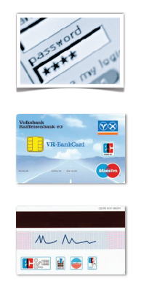
Example
Login to a computer
Authentication by knowledge (password)
Online debit cards
Authentication by ownership (card) and
knowledge (PIN)
Offline debit cards
Authentication by ownership (card) and
human factor (signature)

Slide 5

Multi-Factor Authentication
Authentication using multiple factors
Example: Scene from the movie “Mission Impossible”
Ethan Hunt needs to
use a stolen chip card (ownership factor)
forge a fingerprint (human factor)
enter the terminal room (location factor)
enter a password (knowledge factor)

Slide 6
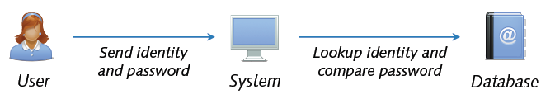
Passwords
Password = information confirming the identity of an entity
Knowledge of a secret word, phrase or number
Often combination with (a)symmetric cryptography
e.g. password is mapped to key of symmetric cipher
e.g. password protects private key of public-key algorithm
Passwords are just great. Wait, it’s not that easy

Slide 7
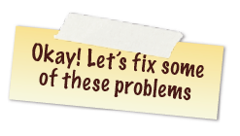
Problems with Passwords
Password snooping
Eavesdropping of passwords in network traffic
Retrieval of passwords from hosts (e.g. via malware)
Password guessing (online) or cracking (offline)
Dictionary attacks = guessing using dictionary of words
Brute-force attacks = guessing using all possible strings
Human deficiencies
Weak and often re-used passwords

Slide 8
Passwords Storage
Passwords should never be stored in clear
Application of cryptographic one-way functions
Only encoded (hashed) passwords are stored
Sony data breach revealed clear text password.
Why twitter auto-reset the passwords recently ?
Example: $stored_pw = hash($password);
Simple to validate: hash($input) == $stored_pw?
Hard to deduce password from strong hash functions
Efficient cracking of stored passwords still possible
Brute-force or dictionary attack using hashed strings

Slide 9

Salted Passwords
Encoding of password with random string (salt)
Example: $stored_pw = hash($password+$salt);
Salt value stored along with hashed password
Cracking of stored passwords more expensive
Same password maps to different hash values
Without salt: cracking depends on # words
With salt: cracking depends on (# words × # salts)
Security depends on quality of password, hash and salt
Notes:
a salt is random data that is used as an additional input to a one-way function that hashes a password or passphrase.
The intent of the salt itself is primarily to defeat pre-computed rainbow table attacks that could otherwise be used to greatly improve the efficiency of cracking the hashed password database.

Slide 10
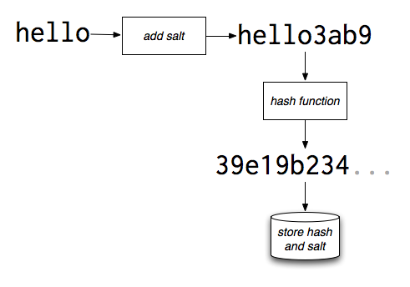

Slide 11
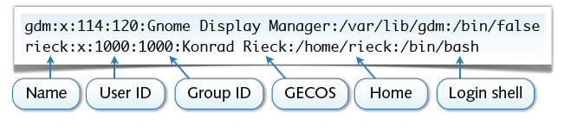
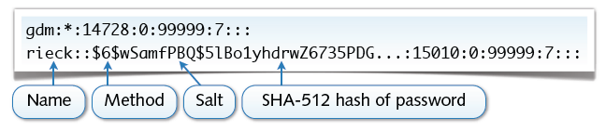
Example: Unix Password
User credentials stored in two separate databases
/etc/passwd Basic user information (publicly readable)
/etc/shadow Salt and hashed passwords (protected)

Slide 12
Good Password?
Testing for insecure passwords is very easy
A normal core i3 laptop can test 21 million MD5 hashs per hour
Passwords should be very hard to guess
No dictionary words, names, dates and patterns
Simple transformations (e.g. reversing) not sufficient
Minimum length and diversity of passwords
Study by Klein from 1989
21% of 13,797 passwords cracked within one week

Slide 13
Selection of Passwords
What about these? Hmh40hcr. and DB:L,I4yF!
Trick: first letters of memorable phrase
“He made him an offer he can't refuse.” = Hmh40hcr.
“Darth Vader: Luke, I am your father!” = DB:L,I4yF!
Trick: interweave words of memorable phrase
“My kingdom for a horse!” = KiHor;NgSe
Avoidance of too common phrases
2bon2b found in 4 out of 30 million passwords

Slide 14
One-time Passwords
Security of passwords “weakens” over time
Password aging = enforced changing of passwords
One-time passwords = passwords used exactly once
Example: S/Key Algorithm
User chooses initial key K1
Recursive hashing: H(K1) = K2, H(K2) = K3,... H(Kn-1) = Kn
One-time passwords: P1 = Kn, P2 = Kn-1, ... Pn = K1
Hard to deduce next password Pi from previous Pi-1

Slide 15
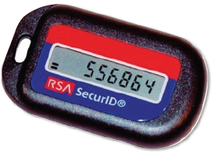
Example: RSA SecureID
Security system using two-factor authentication
Factors: knowledge (password) and ownership (device)
Device generates authentication code every 60 seconds
Authentication using password and current code
Code Generation
Device initialized for each user
with seed (random number)
Code computed from seed and
current time (~one-time password)

Slide 16
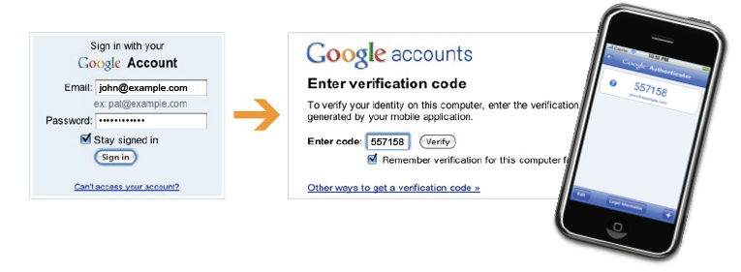
Example: Google 2-Step Verification
Security system by Google similar to SecureID
Factors: knowledge (password) and ownership (phone)
Authentication code computed on mobile phone
Login at Google requires password and current code
https://blog.duosecurity.com/2013/02/bypassing-googles-two-factor-authentication/

Slide 17
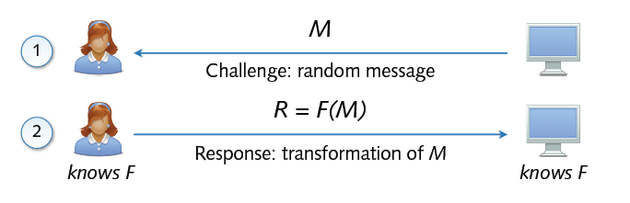
Challenge-Reponse
Generic protocol scheme for authentication
System and user share a secret function F
Advantages over naive authentication methods
Secret, e.g. password, is never transmitted in cleartext
Replay attacks against authentication not possible

Slide 18
Challenge-Response (con’t)
Secret function often parameterized by password
F = H(M + P) hash function H and password P
F = E_{P}(M) encryption function E and password P
Hard to deduce P if F is cryptographically strong
Several methods related to challenge-response scheme
One-time passwords
= challenge (index of password); response (password)
SecurID / Google 2-step
= challenge (current time); response (authentication code)

Slide 19
Example: WPA2 (A Short Excursion)

Slide 20
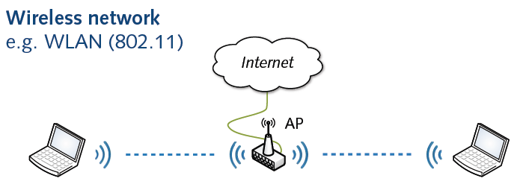
Wireless Networks
Inherent security problems with wireless networks
Communication over shared medium (air)
No physical access control and protection
Need for additional security measures (WEP, WPA, ...)

Slide 21
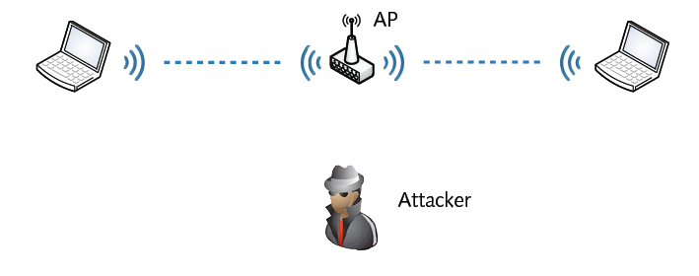
A Closer Look at Attacks
Common attacks types Countermeasures
Masquerading and spoofing ↯ Authentication
Eavesdropping of communication ↯ Encryption
Tampering of messages ↯ Integrity checks
Notes:
Masquerading = Disguise

Slide 22
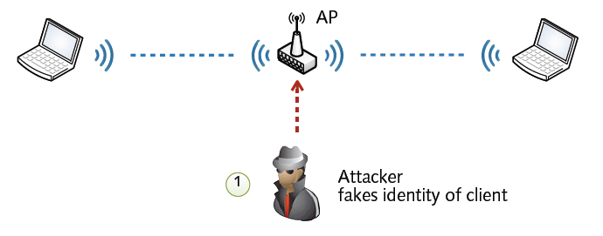
A Closer Look at Attacks
Common attacks types Countermeasures
Masquerading and spoofing ↯ Authentication
Eavesdropping of communication ↯ Encryption
Tampering of messages ↯ Integrity checks

Slide 23
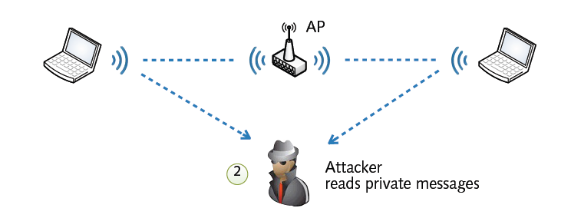
A Closer Look at Attacks
Common attacks types Countermeasures
Masquerading and spoofing ↯ Authentication
Eavesdropping of communication ↯ Encryption
Tampering of messages ↯ Integrity checks

Slide 24
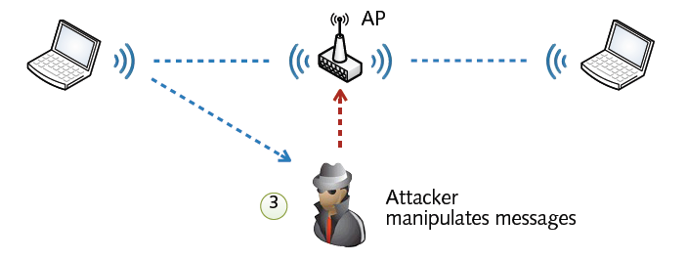
A Closer Look at Attacks
Common attacks types Countermeasures
Masquerading and spoofing ↯ Authentication
Eavesdropping of communication ↯ Encryption
Tampering of messages ↯ Integrity checks

Slide 25
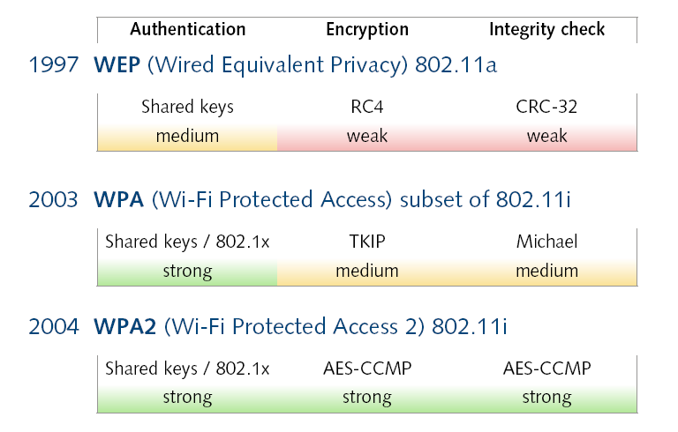
802.11 and Security
TKIP = Temporal Key Integrity Protocol
AES-CCMP = Counter Cipher Mode with Block Chaining Message Authentication Code Protocol
Notes:
TKIP = Temporal Key Integrity Protocol
AES-CCMP = Counter Cipher Mode with Block Chaining Message Authentication Code Protocol

Slide 26
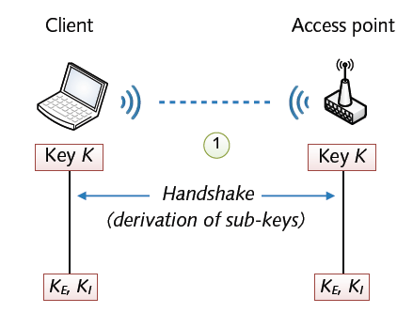
WPA2 Authentication
Two different modes for authentication in WPA2
Personal: Pre-shared keys (PSK) (aka “passwords”)
Enterprise: 802.1x with Extensible Authentication Protocol
Key Exchange: The client and access point start with a shared key (Key K).
Four-way Handshake: This process generates unique sub-keys for encryption and integrity protection between the client and access point.
Sub-keys (Ke, Ki): Derived from the original shared key, these sub-keys are used to encrypt and secure the communication between the devices.

Slide 27
Chat gpt content for above slide
The above slide explains the two different authentication modes in WPA2 and provides an overview of the handshake process involved in establishing a secure connection between a client (like a laptop) and an access point (e.g., a Wi-Fi router).
1. WPA2 Authentication Modes:
Personal Mode:
Uses Pre-shared Key (PSK), which is commonly referred to as a "password."
This mode is typically used in home or small office networks.
The PSK is shared among all devices on the network, and each device must know this password to connect.
Enterprise Mode:
Uses 802.1x with Extensible Authentication Protocol (EAP).
Commonly used in larger organizations, it provides stronger security than PSK.
In this mode, each user can have individual login credentials, which are validated through a central authentication server. This enables better control and tracking of users on the network.

Slide 28
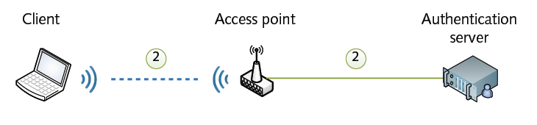
WPA2 Authentication
Two different modes for authentication in WPA2
Personal: Pre-shared keys (PSK) (aka “passwords”)
Enterprise: 802.1x with Extensible Authentication Protocol

Slide 29
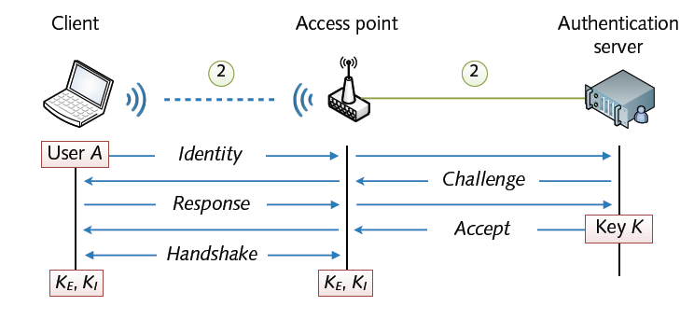
WPA2 Authentication
Two different modes for authentication in WPA2
Personal: Pre-shared keys (PSK) (aka “passwords”)
Enterprise: 802.1x with Extensible Authentication Protocol

Slide 30
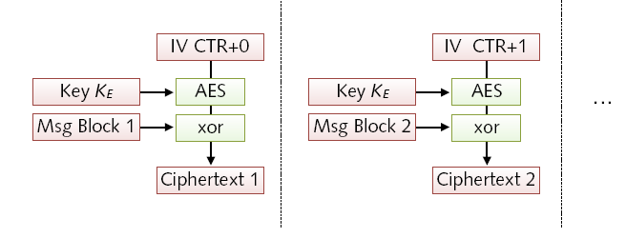
WPA2 Encryption
Partitioning of each message in blocks
Encryption of each message block in counter mode
Advanced Encryption Standard (AES) using key KE

Slide 31
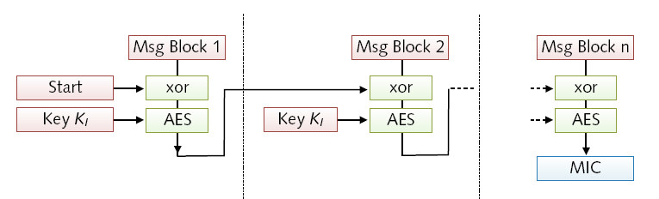
WPA2 Integrity Check
Chaining of cipher blocks to a keyed hash value
Message Integrity Code (MIC) using key K_{I}
MIC appended to message prior to encryption

Slide 32
How secure is WPA2?
Attacks against WPA2
(Almost) no attacks against cryptographic protocol
Best attack strategy so far: brute-force attacks
Target for potential attacks: Complexity of protocol
WPA2 security in practice
Strength of passphrase in personal mode
Strength of authentication protocol in enterprise mode

Slide 33
Access Control

Slide 34
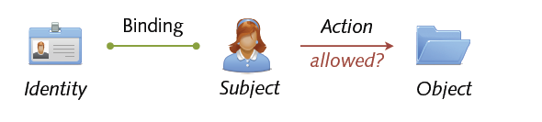
Access Control
Authorization and access control
Control of what a subject is allowed to do
Management of permissions and capabilities
Often tight coupling with authentication
Examples
Execution of programs, reading of files, ...

Slide 35
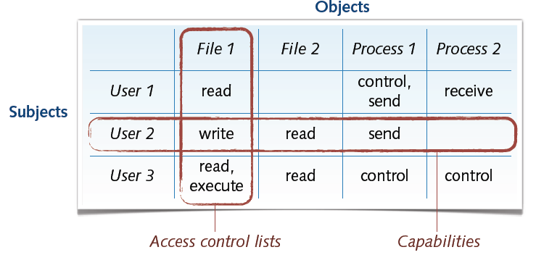
Access Control Matrix
Classic and simple representation for access control
Mapping from subjects and objects to permissions

Slide 36
Access Control Models
Access control non-trivial in practice
Complex systems ⇝ complex access control models
Some characteristics of access control models
Definition of objects and subjects
E.g. subjects can be users, processes or hosts
Representation of permissions
E.g. columns (access control lists), rows (capabilities)
Management of permissions
E.g. discretionary, mandatory or role-based access control

Slide 37
Representation: Access Control Lists
Access control lists (ACL)
Attachment of permissions to objects (columns)
⊕ Efficient and decentralize organization of permissions
⊖ Listing of subject permissions very involved
Example: OpenBSD packet filter
Deny access to the SSH service from any host
→ block in quick proto tcp from any to any port ssh

Slide 38
Representation: Capabilities
Capabilities
Attachment of permissions to subjects (rows)
⊕ Listing and control of subject permissions simple
⊖ Fine-grained permissions difficult to implement
Example: Linux capabilities
Restrict permissions to reboot system and load modules
→ lcap -z CAP_SYS_BOOT CAP_SYS_MODULE

Slide 39
Management of Permissions
Discretionary Access Control (DAC)
Owner of an object controls access
Convenient but insecure if object changes owner
Mandatory Access Control (MAC)
System globally enforces access control
Very secure but tedious to design and operate
Role-based Access Control (RBAC)
System enforces access control using roles
In-between DAC and MAC models

Slide 40
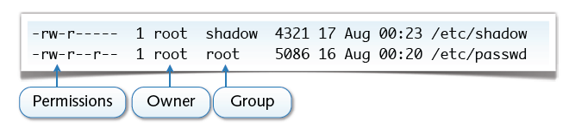
Example: UNIX Permissions
Discretionary access control of files
Owner manages permissions of his files
Fixed-size access control lists: rwx rwx rwx
Three subjects: user, group and other
Three permissions: read, write and execute
(a) Everybody can read the passwd file; root can write to it
(b) Only root and the group shadow can read the shadow file

Slide 41
Example: UNIX Permissions (con’t)
Simple notation for management of permissions
<subjects> +|-|= <permissions>
Subjects: u (user), g (group), o (others), a (all)
Permissions: r (read), w (write), x (execute)
Examples
Make file readable to everyone: chmod a+r file
Remove write permission from group: chmod g-w file
Make file readable by user only: chmod u=r file
Alternative for UNIX gurus: octal encoding

Slide 42
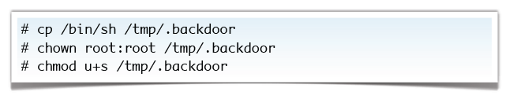
Special Permissions
Some permissions with special semantics
+x makes directories searchable
+t sticky bit (for directories deletion is restricted)
+s suid bit (change user id to file owner during execution)
A UNIX backdoor from the 1990s
If it’s bad, why do we need the suid bit?

Slide 43
Acknowledgements
Material in this lecture are taken from the slides prepared by:
Prof. Dr. Konrad Rieck (Uni-Göttingen)

